Slide 1

DATA MANIPULATION
PROJECT
Life Expectancy (WHO)
Sefa Sahan
A. Ilter Juan Obregon

Slide 2
Description
Although there have been lot of studies undertaken in the past on factors affecting life expectancy considering demographic variables, income composition and mortality rates. It was found that affect of immunization and human development index was not taken into account in the past. Also, some of the past research was done considering multiple linear regression based on data set of one year for all the countries. Hence, this gives motivation to resolve both the factors stated previously by formulating a regression model based on mixed effects model and multiple linear regression while considering data from a period of 2000 to 2015 for all the countries. Important immunization like Hepatitis B, Polio and Diphtheria will also be considered. In a nutshell, this study will focus on immunization factors, mortality factors, economic factors, social factors and other health related factors as well. Since the observations this dataset are based on different countries, it will be easier for a country to determine the predicting factor which is contributing to lower value of life expectancy. This will help in suggesting a country which area should be given importance in order to efficiently improve the life expectancy of its population.

Slide 3
RESEARCH QUESTIONS
RESEARCH QUESTIONS
Does various predicting factors which has been chosen initially really affect the Life expectancy? What are the predicting variables actually affecting the life expectancy?
Should a country having a lower life expectancy value(<65) increase its healthcare expenditure in order to improve its average lifespan?
How does Infant and Adult mortality rates affect life expectancy?
Does Life Expectancy has positive or negative correlation with eating habits, lifestyle, exercise, smoking, drinking alcohol etc.
What is the impact of schooling on the lifespan of humans?
Does Life Expectancy have positive or negative relationship with drinking alcohol?

Slide 4
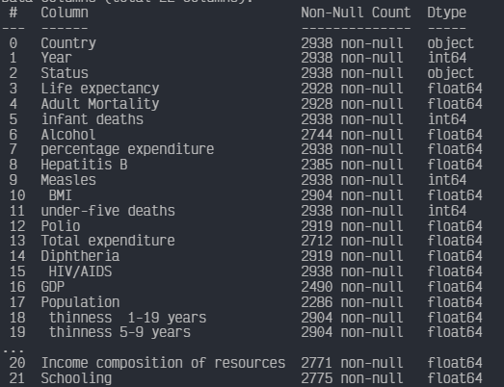
CLEANING
We check if values are missing or invalid (NaN, null, etc.)
Handle missing or invalid values by imputing, removing, or replacing them as appropriate.
We make sure that the data is in the correct format (for example, dates are in the correct format, categorical variables are correctly encoded, etc.)

Slide 5
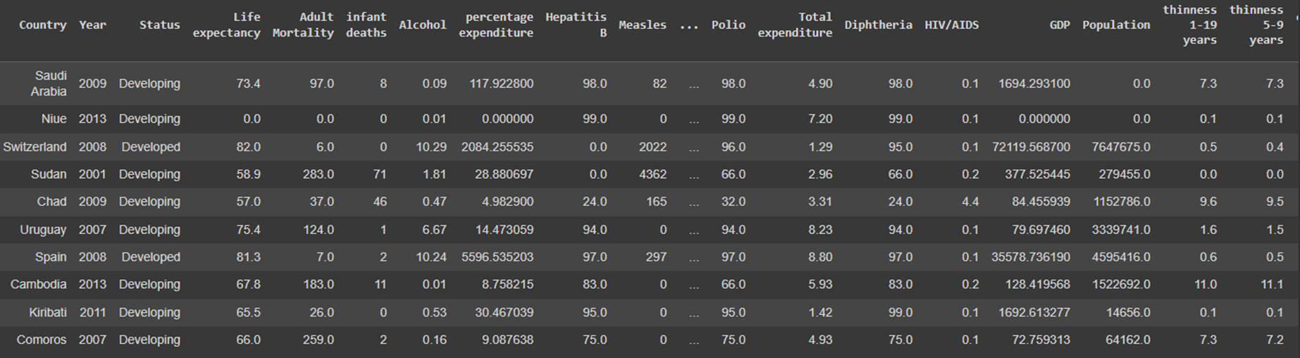
ANALYSIS
Get a general understanding of the data by calculating descriptive statistics such as mean, median, mode, etc.
Conduct exploratory data analysis (EDA) to identify patterns, relationships, and trends in the data.
Compare and contrast different variables in the data to gain further insights. For example, you can compare the distributions of different variables or the relationships between different variables.

Slide 6
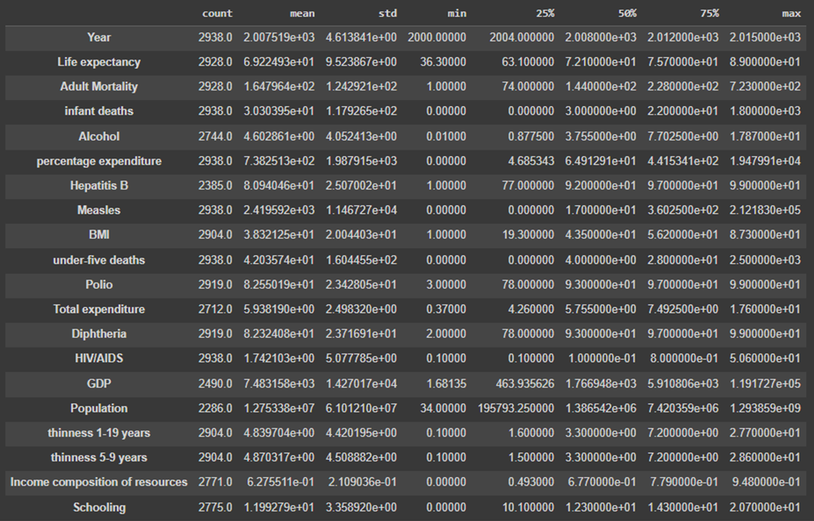
ANALYSIS

Slide 7
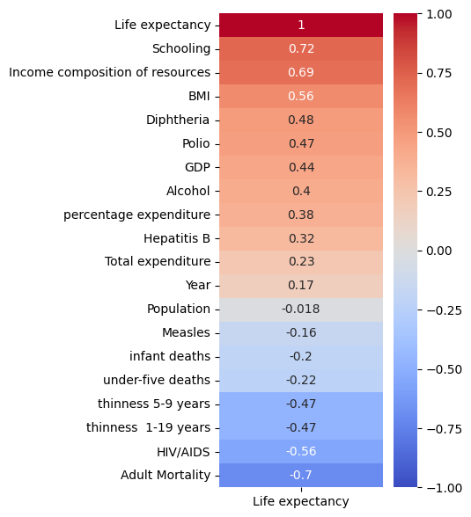
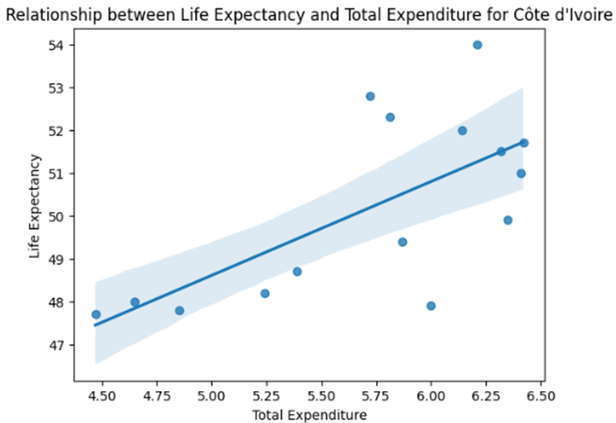
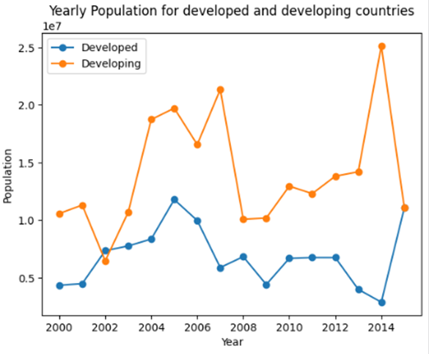
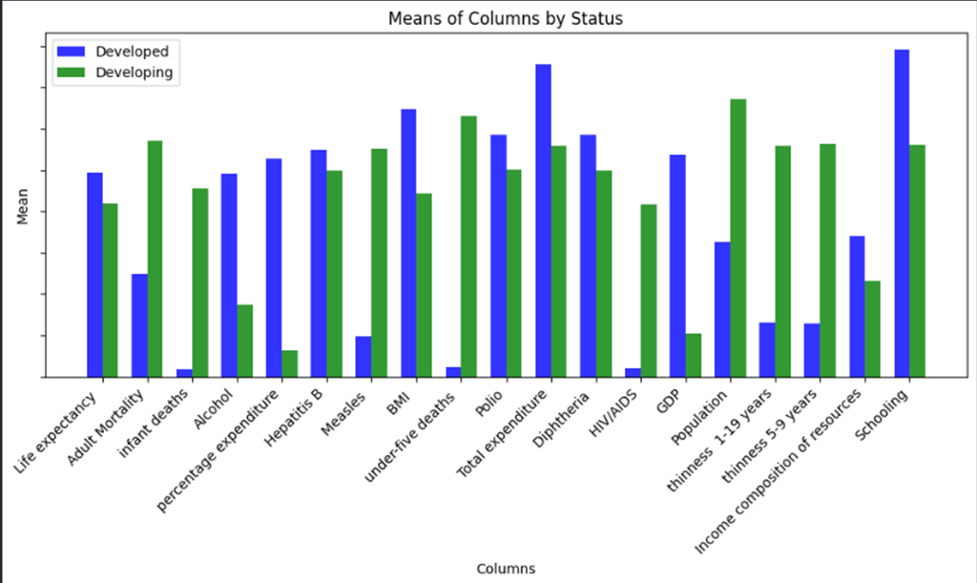
VISUALISATION

Slide 8
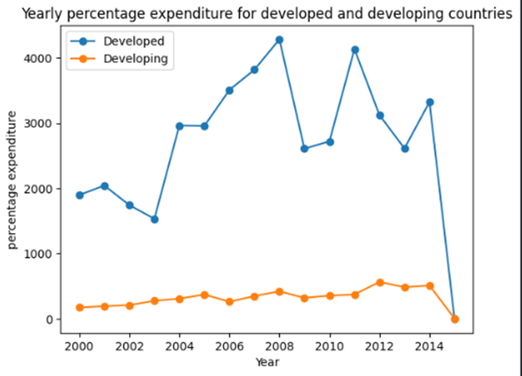
PROBLEMS FOUND
Within the cleaning stage we were able to identify several inconsistencies in the dataset such as:
Incomplete columns with null data.
Several columns had the value 0.
Severe changes in data values between the different countries that made up the data set.
Among others findings.

Slide 9
SOLUTION
Below we present the solutions, findings and conclusions of our project…
Thank you very much
for your attention and your time !

